Slide 1
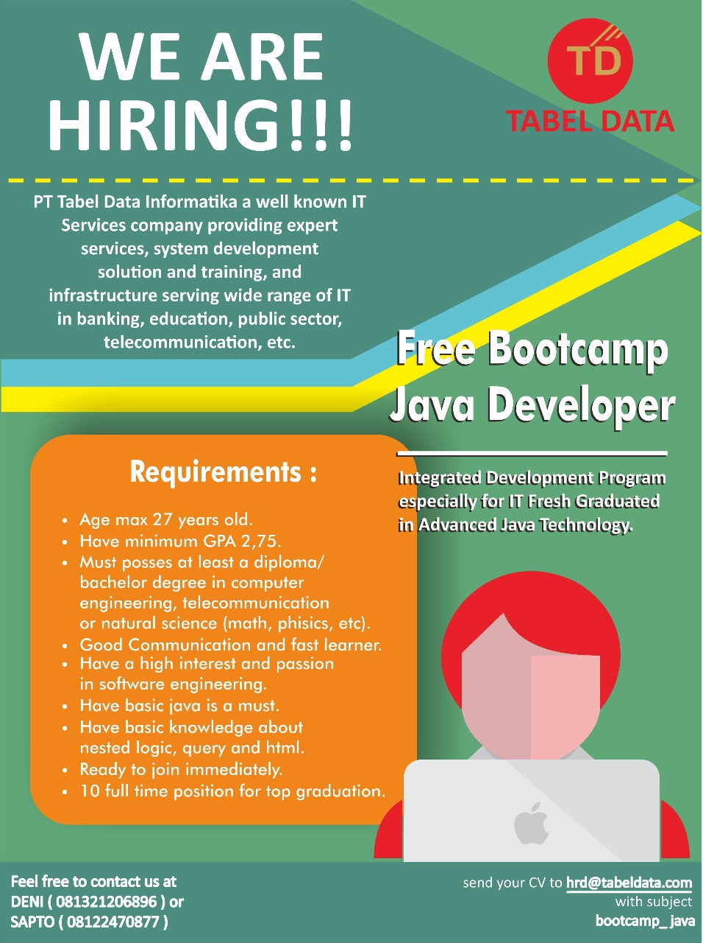
Bootcamp Java Developer #Day 5
PT. Tabel Data Infromatika
By Dimas Maryanto,S.Kom

Slide 2
Angular2

Slide 3






Setup Development Environtment

Slide 4
Component

Slide 5
Modules

Slide 6
Services

Slide 7
Class & Interface

Slide 8
HTTP

Slide 9
Routing

